Slide 1

Customized Event Alert For Websites
Guide
SILPA SANGEETH L R,
Assistant Professor,
Department of Information Technology,
Government Engineering College Palakkad
Group number : 1
AYSHA C M
BALASUBRAMANIAN T K
MEENAKSHI SUNIL
MUHAMMED SUHAIL A H

Slide 2
01
02
TABLE OF CONTENTS
Problem Statement
05
06
References
Progress & Implementation
03
Mailer
GUI
Forms
GUI
04
Tools & Packages

Slide 3

Problem Statement
To build an alert system that continuously monitors and scrapes the events from websites, which then pushes it through some medium for users

Slide 4
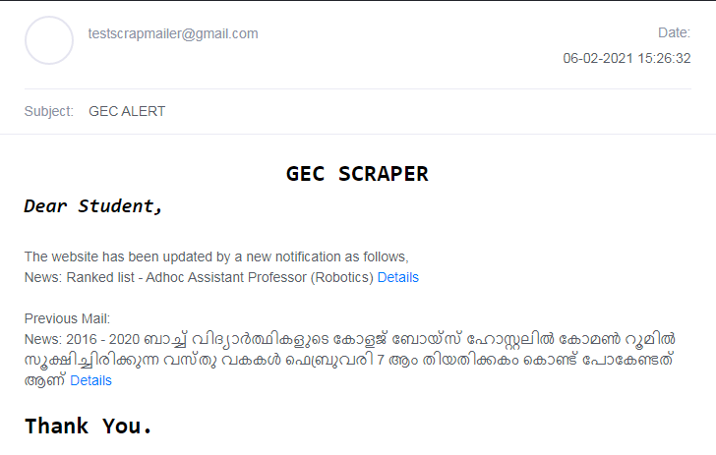
Mailer GUI

Slide 5
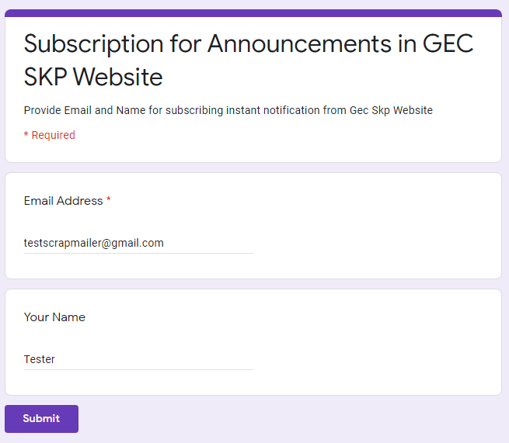
Forms GUI

Slide 6
Progress
Created forms as per GUI and linked it with Google sheets. Also fixed errors in script (Done by Aysha)
Scripted the body of mail as per GUI (Done by Meenakshi)
Connected Google Sheets with Colab API and took the recipients (Done by Suhail)
Connected SMTP Google Client with SSL connection (Done by Balasubramanian)
Scraped the contents from website (Have evenly distributed contributions by everyone)

Slide 7
Implementation
Incognito:
id: testscrapmailer@gmail.com
pass: testscraper
https://docs.google.com/spreadsheets/d/1a4LOWMD8b-IGdfVk3N6Z5PT9ZoRjftz6_eKDkWu_yP4/edit#gid=1531000488 (Spreadsheet)
https://forms.gle/kR78VmN6k1MDGG8q9 (User interface Forms)
https://colab.research.google.com/drive/1Iaf_DDR_LDdbskRASBIQQDqzxhgua_2d#scrollTo=llfqbQT_n9Zd (Script)
https://docs.google.com/forms/d/1cstY5Gj3UMLwrwCH3vD0ezISmxJEeau2gZTBXWlQIgk/edit (Forms Edit)

Slide 8
Tools
Packages
Language : Python
Editors : VSCode, Google Colab
Collaboration : Github
Mailer : Gmail Client
Mailer Storage : Google Drive
Scraper : beautifulSoup.htmlparser
Connection : urllib.request
Storage : csv.write
Mailer API: SMTP Client(465)
SpreadsheetAPI : gspread

Slide 9
References
Fujiwara, K., Nomura, Y., & Taniguchi, H. (2010). A Mailing List Management System Mashing-up with Web Services. In the proceedings International Conference on Broadband, Wireless Computing, Communication and Applications.
Maududie, A., Retnani, W. E., & Rohim, M. A. (2018). An Approach of Web Scraping on News Website based on Regular Expression. The 2nd East Indonesia Conference on Computer and Information Technology (EIConCIT) 2018 .
Zhou, Y. C., Xue, L., Liu, X. P., Wang, X. N., Liang, X. X., & Sun, C. H. (n.d.). 2010 IEEE : A Self-Service Telecommunication Service Delivery Platform with Platform-as-a-Service Technology. 6th World Congress on Services. Service Storm

Slide 10
THANKS

